Slide 1
CEF440 · Mobile Programming Projects 2025–2026
Task 4
System Modelling & Design
Adaptive E-learning Platform for Low-Resource Settings
System Modelling
Context Diagram
Sequence Diagram
Dataflow Diagram
Class Diagram
Use Case Diagram
Deployment Diagram

Slide 2
Task 4: System Modelling & Design
What is system modelling?
System modelling uses abstract diagrams to represent the structure, behaviour, and deployment of a software system — before any code is written. This helps the team agree on what to build, catch design problems early, and communicate the architecture to stakeholders.
Clarity
Communication
Risk reduction
Forces the team to agree on structure and boundaries before implementation begins.
Gives non-technical stakeholders (lecturers, clients) a visual language for the system.
Reveals conflicts, missing components, or overloaded dependencies early when changes are cheap.
This task covers six UML diagrams across Weeks 7–8, each capturing a different view of the system.

Slide 3
Project recap
Adaptive E-learning Platform for Low-Resource Settings
The system must dynamically adapt content delivery to network conditions (bandwidth, latency, packet loss) while maintaining a satisfying Quality of Experience for students and instructors in settings like Cameroon, where mobile data is the primary connection.
Student
Instructor
Administrator
Register & login
Access courses & content
Take quizzes
Receive adaptive content
Download for offline use
Rate content quality
Create & manage courses
Upload content (video, PDF, audio)
Set learning objectives
View student progress
Manage assessments
Manage users
Monitor system performance
Configure adaptive settings
Manage QoE thresholds
Generate reports
System actors identified during Task 2 requirement gathering

Slide 4
01 Context Diagram
It shows the system as a single black box at the centre, showing all external entities that interact with it and the data flows crossing the system boundary. It is the highest-level diagram — no internal detail, only the system boundary and who talks to it.
Key external entities
› Student (mobile client)
› Administrator (web dashboard)
› Cloud storage / CDN
› Instructor (mobile / web client)
› Mobile network / ISP
› Push notification service

Slide 5
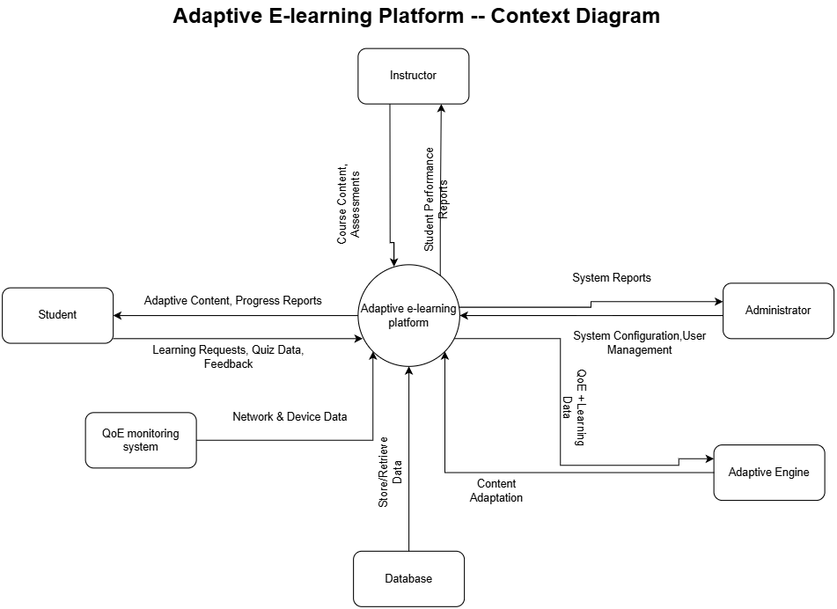

Slide 6
02 Dataflow Diagram (DFD)
It shows how data moves through the system — from input by external entities, through processing functions, into and out of data stores. A Level-0 DFD is essentially the context diagram (as shown previously). Level-1 breaks the system into its main processes.
Key processes (Level 1)
1.0 User Authentication
4.0 Adaptive Engine (content selection)
2.0 Course & Content Management
5.0 Assessment & Progress Tracking
3.0 QoE Monitoring & Analysis
6.0 Offline Content Sync

Slide 7
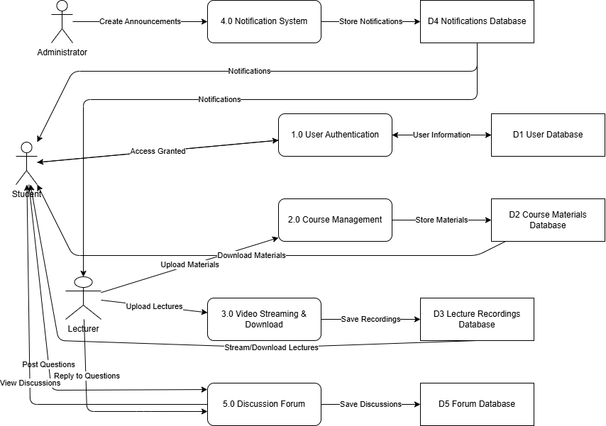
System Dataflow Diagram (DFD)

Slide 8
03 Use Case Diagram
It shows how each actor interacts with the system through named use cases. The system boundary is an oval containing use cases; actors sit outside it with association lines.
Actor
Use cases
Student
Register/Login · Enroll · View content · Take quiz · Download offline · Rate quality
Instructor
Register/Login · Create course · Upload content · Set objectives · View progress
Admin
Manage users · Monitor system · Generate reports · Set QoE thresholds
QoE Monitor
Monitor bandwidth · Detect device type · Measure latency · Send data to engine
Adaptive Engine
Analyse QoE data · Select content format · Adjust quality · Recommend path

Slide 9
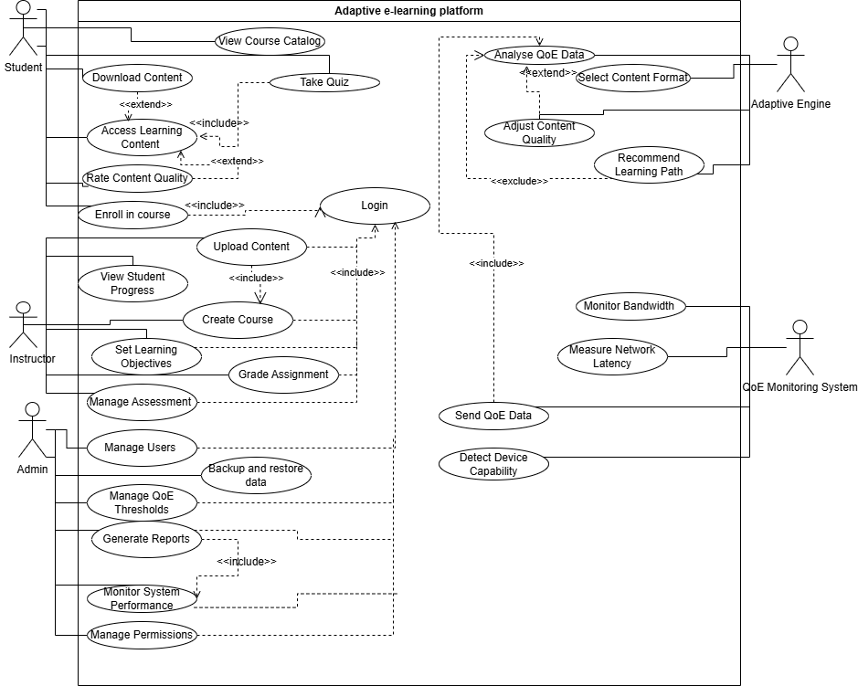
System Use Case Diagram

Slide 10
04 Sequence Diagram
It shows the time-ordered exchange of messages between objects for a specific scenario. Lifelines run vertically; arrows show method calls and returns. Good for showing complex time-sensitive interactions like QoE-driven adaptation.
Scenarios modelled
1
Student login and course access
4
Student takes quiz — progress tracked
2
QoE degradation — adaptive content switch
5
Offline download and sync on reconnection
3
Instructor uploads video to CDN

Slide 11
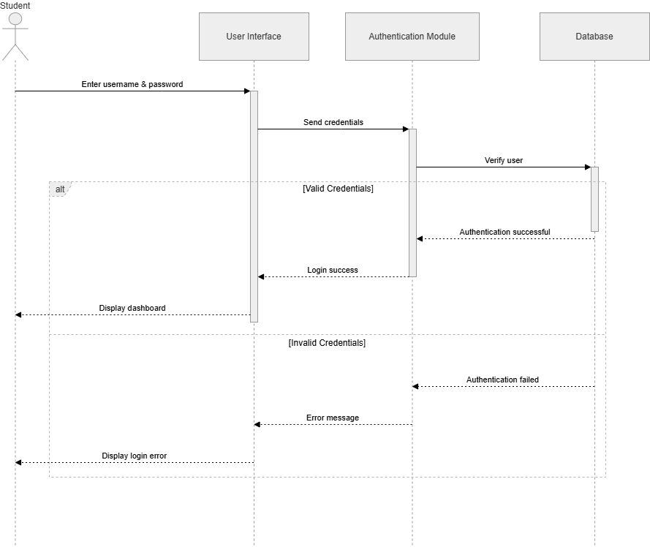
Sequence Diagram Examples
Example: Student Login Sequence Diagram

Slide 12
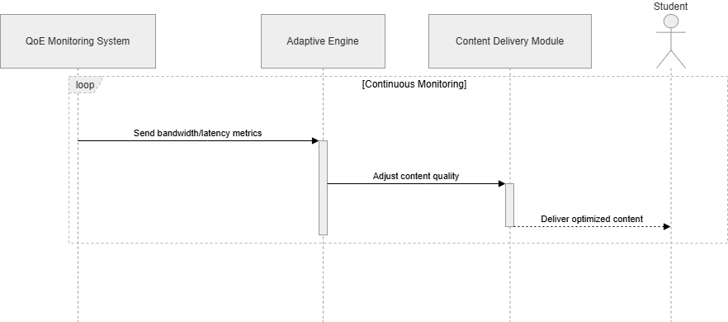
Sequence Diagram Examples
Example: QoE Monitoring and Dynamic Adaptation Sequence Diagram

Slide 13
05 Class Diagram
What it shows
The static structure: classes, their attributes and operations, and the relationships between them (association, inheritance, aggregation, dependency). This directly maps to the objects defined in Task 2.
Class
Key attributes
User
userID, name, email, password, role
QoEMonitor
monitorID, bandwidth, latency, deviceType
Student
studentID, enrolledCourses, progressLevel
AdaptiveEngine
engineID, threshold, contentFormat
Instructor
instructorID, coursesTaught, expertise
Assessment
assessmentID, questions, score, attempts
Course
courseID, title, description, difficulty
Enrollment
enrollmentID, date, status
Content
contentID, type, format, size, quality
ProgressTracker
trackID, completionRate, lastAccessed
Key relationships: Student and Instructor inherit User · Student — Enrollment — Course · Course contains many Content · QoEMonitor feeds AdaptiveEngine

Slide 14
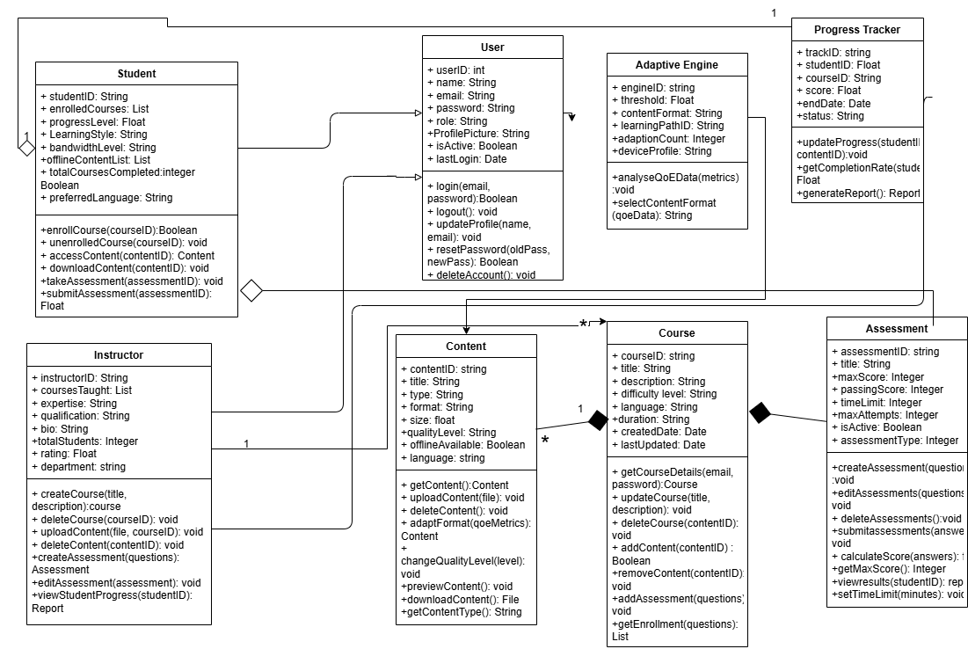
System Class Diagram

Slide 15
06 Deployment Diagram
It shows where each software artifact is deployed, on what physical or virtual node, and how those nodes communicate. It captures the hardware, cloud services, mobile devices, and the protocols linking them.
Student device
Mobile App (APK/IPA) · QoE Monitor · Offline cache (SQLite)
Instructor device
Mobile App (APK/IPA) · Content upload module
Cloud app server
REST API · Adaptive Engine · Auth Service · QoE Service · Progress Tracker
Database server
App Database (PostgreSQL) · QoE Logs DB
CDN / Cloud storage
Video / Audio files · PDFs & Notes
Protocols: HTTPS (all tiers) · WebSocket / WSS (QoE telemetry) · SQL/TCP (API to database) · CDN pull (direct content to mobile)

Slide 16
06 Deployment Diagram — Architecture view
CLIENT
Student device
Instructor device
Admin browser
Mobile App + QoE monitor
Mobile App + upload
Web dashboard
HTTPS
SERVER
Cloud application server (AWS EC2 / Firebase / Render)
REST API
Adaptive Engine
Auth Service
QoE Service
Progress Tracker
Push Notifier
SQL/TCP
HTTPS
DATA / CDN
Database server
CDN / Cloud storage
Device storage
App DB + QoE Logs
Videos, Audio, PDFs
Offline cache

Slide 17
How the diagrams connect
Context
DFD
Use Case
Sequence
Class
Deployment
Defines system boundary and external entities
Shows how data flows between those entities
Maps actors to specific interactions
Details message order for each use case
Defines the structure of all objects
Maps services to physical nodes
Each diagram builds on the previous one. Context sets the boundary, DFD shows data movement, Use Case maps interactions, Sequence shows time-order, Class defines the data model, and Deployment shows where everything runs.
Diagram
Contribution to implementation
Context
API entry points, integration contracts
DFD
Service boundaries, data store schema
Use Case
Feature list and test cases
Sequence
API call signatures, event handlers
Class
Database models, OOP structure
Deployment
Infrastructure config, DevOps setup

Slide 18
Summary
System Modelling & Design
Context Diagram
DFD Level 1
Boundary and external actors defined
6 core processes identified
Use Case Diagram
Sequence Diagram
3 primary + 2 secondary actors, 20+ use cases
5 key scenarios modelled
Class Diagram
Deployment Diagram
11 classes with attributes and relationships
3-tier architecture: client / server / data + CDN

